Slide 2
Loyal Subjects to Independent States after the French & Indian War

Slide 3
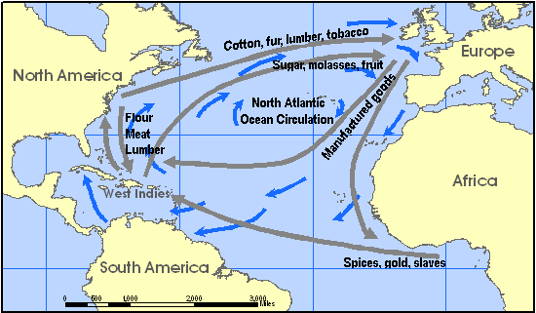
British AND Independent:
Economic Independence:
The Poorly Enforced Navigation Acts

Slide 4
French and Indian War
What was purpose
What was the outcome
What resulted

Slide 5
Purpose of French & Indian War
Push French out of needed territory
Grow the Colonies
Economic Opportunities

Slide 6
Geographic Expansion Population Boom
Year | Colonial Population
1625 | 1,980
1641 | 50,000
1688 | 200,000
1702 | 270,000
1715 | 434,600
1749 | 1,046,000
1754 | 1,485,634
1765 | 2,240,000
1775 | 2,418,000

Slide 7
The Need to Expand

Slide 8
What was Outcome
England had extensive war debt
Differing views on how the war was won
British
Colonists
Increased colonies belief in self-sufficiency

Slide 9
Suspension of “Salutary Neglect”
The unofficial, long-term seventeenth- and eighteenth-century British Crown policy of avoiding strict enforcement of parliamentary laws meant to keep American colonies obedient to England.
The British mindset was now the colonies needed to start “Paying their Bills.”

