Slide 1
Growing Pains of a New Nation

Slide 2
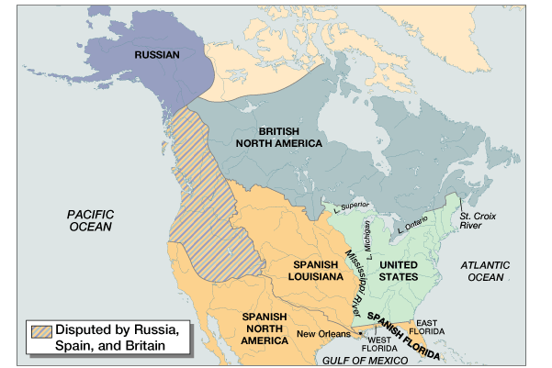
America After the Treaty of Paris of 1783

Slide 4
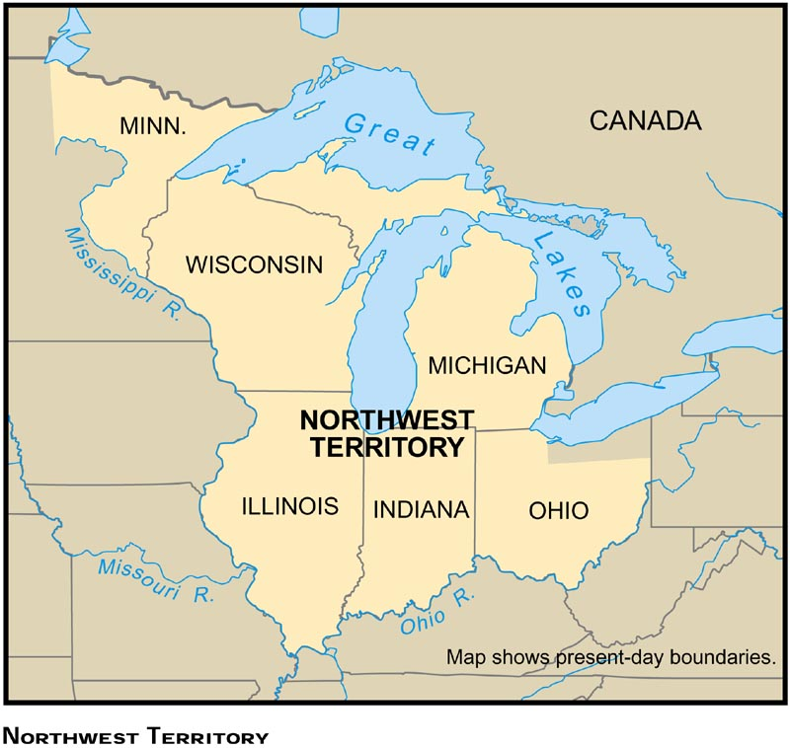
The Northwest Territory

Slide 5
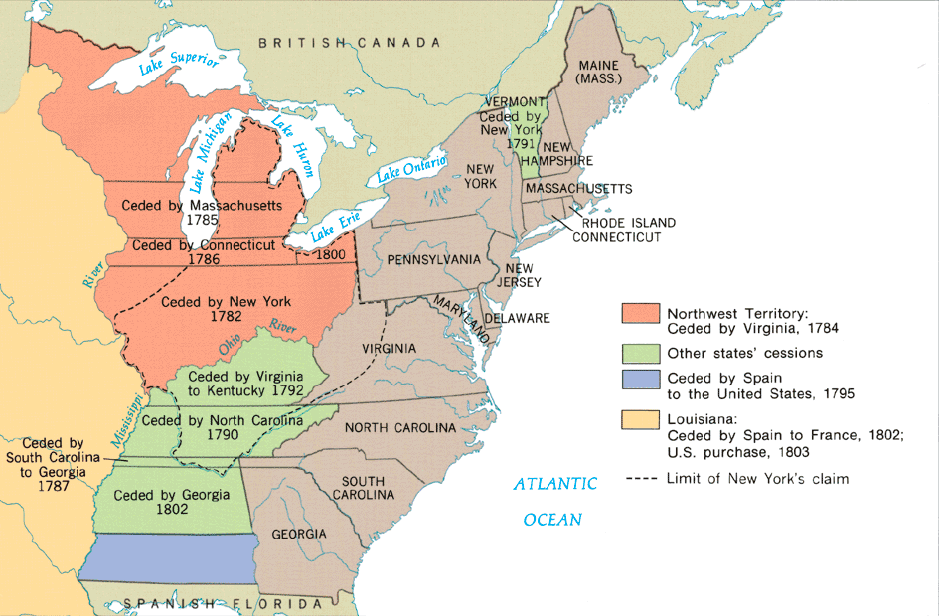
Western Land Given to the U.S, 1782–1802

Slide 6
I. Constitutional Convention (1787):
Closed (not open to public) meeting between the delegates (representatives) from the 13 states.
Meeting took place in Philadelphia, Pennsylvania between May 25th and September 17th, 1787.
Delegates planned to amend (change) The Articles of Confederation.

Slide 7
Results:
Delegates decided to scrap The Articles of Confederation and develop a new form of government.
It was a very long process which required a lot of compromise between states.
*George Washington was nominated to be president of the Convention.
**James Madison took very careful notes of the debates and discussions during the Convention.

Slide 8
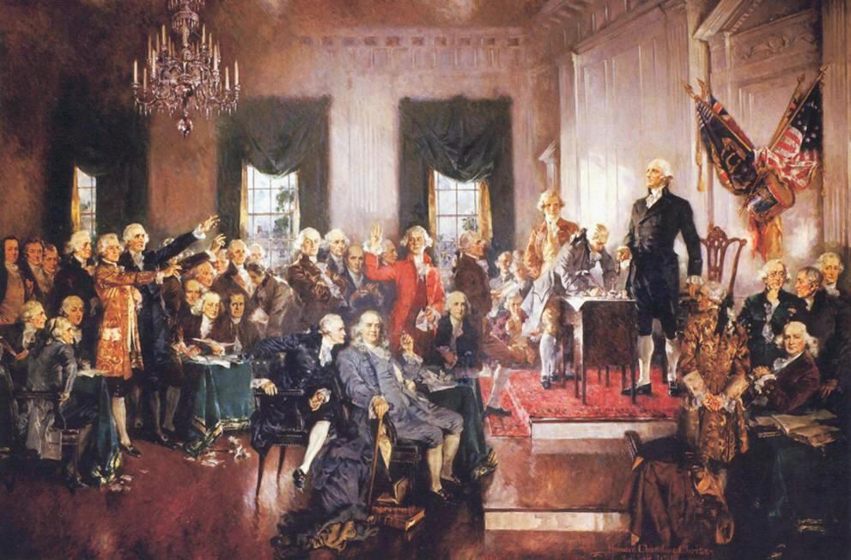
II. Major Arguments During The Constitutional Convention:

Slide 9
1. Representation of Large & Small States:
Large & small states argued over how their state would be represented.
Large (population) states felt they should have more say (power).
Small (population) states felt they should have equal say (power).
Results:
Two plans were proposed.
The debates over the issue of representation got so heated, the Convention almost ended.

Slide 10
a. Virginia Plan:
Favored the large states.
Each state would be given a number of votes / delegates based on their states’ population.
Proposed by James Madison of Virginia.

Slide 11
b. New Jersey Plan:
Favored the small states.
Each state would be given the same number of votes / delegates regardless of their states’ population.
Proposed by William Paterson of New Jersey.

Slide 12
A. Solution = The Great Compromise:
Used parts of both the Virginia & New Jersey Plan.
Set up a bicameral (two-house) legislature.
Proposed by Richard Sherman of Connecticut.

Slide 13
Results:
Senate (small states):
2 Senators per state regardless of population.
100 Senators total (today)
**from New Jersey Plan
House of Representatives (large states):
Votes / delegates per state based on population.
435 members of the House (today).
**from Virginia Plan
Problem of how to organize Congress was solved.
The Great Compromise satisfied both large & small states.

Slide 14
2. Slavery:
Some delegates from northern states wanted to abolish (end) the slave trade and slavery.
Many delegates from southern states threatened to leave the union if the slave trade or slavery were abolished in the U.S.

Slide 15
Results:
The word slavery does not appear in the Constitution.
Delegates agreed that;
The slave trade would not be discussed in Congress until 1808.
A $10 tax would be placed on the importation of each slave.
Runaway slaves would be returned to a state of slavery.
*Slavery was formally abolished with the ratification of the 13th Amendment (1865).

Slide 16
3. Representation of the Slave Population:
Southern states wanted to count their slave population toward representation.
Southern states would get more delegates in The House of Representatives & have more electoral votes for the presidency.
Northern states did not want the slave population counted.
Results:
Solution = The 3/5’s Compromise:
Every 5 slaves counted as 3 free people for both taxation and representation.
*Without the 3/5’s Compromise, Thomas Jefferson would not have won the election of 1800.

Slide 17
4. Ratification of the Constitution:
ratification = approval, acceptance
9 of 13 states had to ratify (accept) the Constitution before it became law.
Result:
Two groups fought over this issue (Federalists & Anti-Federalists).

Slide 18
A. Anti-Federalists:
Opposed the new Constitution.
Believed the Constitution would create too strong a central (federal) government that would threaten individual freedom.
Wanted individual freedoms (Bill of Rights) to be outlined in the Constitution.
Anti-Federalists were supported by men like Patrick Henry, Samuel Adams, and George Clinton, New York’s first governor.

Slide 19
B. Federalists:
Supported the new Constitution.
Argued that a much stronger central (federal) government was needed to preserve (keep) the United States.
Believed the U.S. would not survive under the Articles of Confederation.
Federalist Papers = a series of essays written in favor of the Constitution that were printed around the country.
Federalists papers were written by James Madison, Alexander Hamilton, and John Jay**

Slide 20
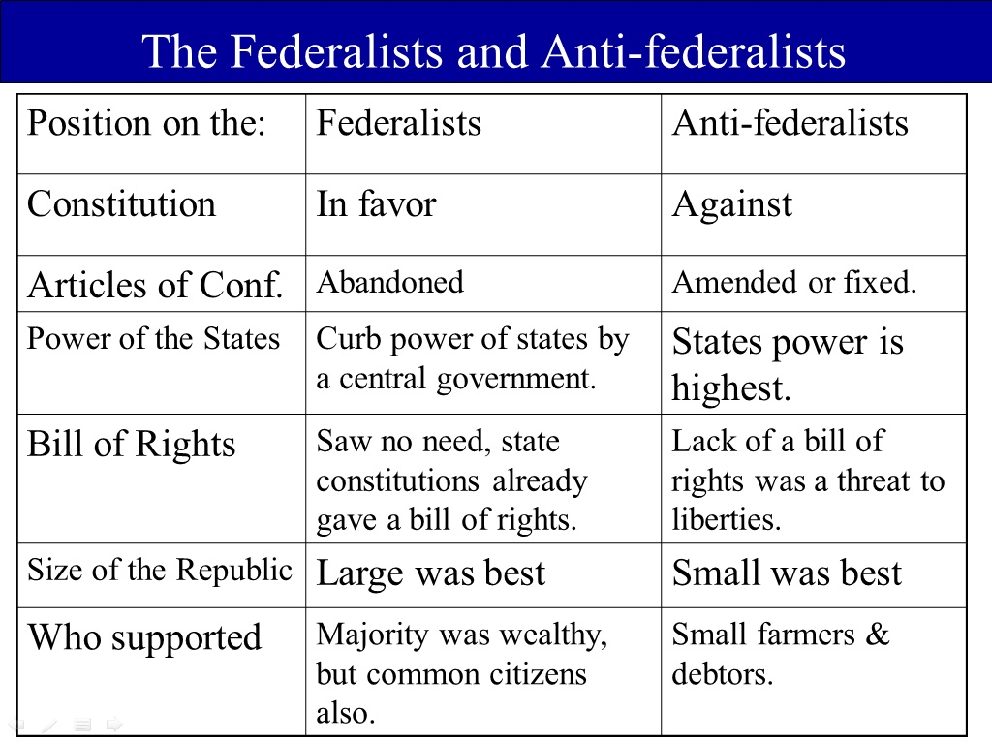

Slide 21
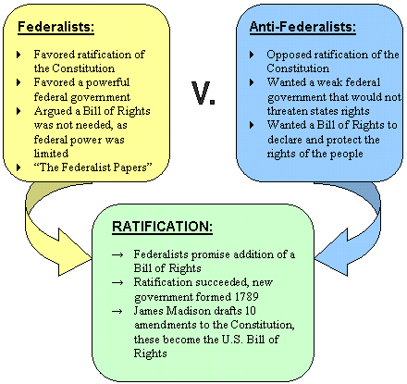

Slide 22
III. The Constitution Was Ratified (1789):
11 of 13 states’ delegates ratified the Constitution.
The delegates had to get approval from their states’ legislature.
The Preamble (Introduction) clearly states where the power to govern came from; “We The People…”
Results:
It took almost 2 ½ years for all 13 states to ratify the Constitution.
Many delegates believed that a bill of rights needed to be added to the Constitution to protect individual rights, liberties, and freedoms.

Slide 23
Growth of Early America
Population was doubling about every 25 years. First census in 1790- 4 million Americans
90% rural population
Vermont, Kentucky, Tennessee, and Ohio would be added as states within the first fourteen years of the new government

Slide 24
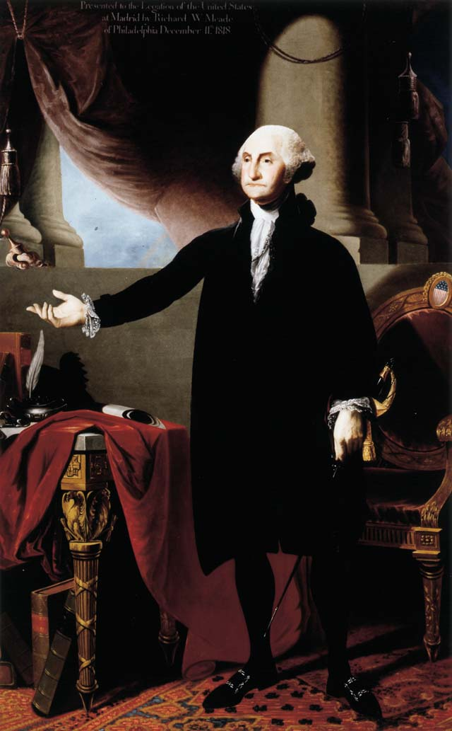
The First President
Washington unanimously elected as president in 1789 by the Electoral College
First capital of the U.S. was in New York City
Establishment of the cabinet
No mention of a presidential cabinet in the
Constitution, but it became necessary.
Secretary of State- Thomas Jefferson
Secretary of Treasury- Alexander Hamilton
Secretary of War- Henry Knox
“I go to the chair of government with feelings not unlike those of a culprit who is going to the place of his execution.”
~ George Washington ~

Slide 25
Influence of Alexander Hamilton
Economic goal was to correct the problems under the Articles of Confederation
Objective was to improve the national credit
Encouraged Congress to pay off its debts at face value plus interest, and take on the debts of the states (54 million national, 21.5 million states)
States with heavy debts liked the idea, states with small debts didn’t
Compromise was for federal government to assume state debts, and the District of Columbia would be located on the Potomac River between Virginia and Maryland

Slide 26
Financing the Debt
Hamilton convinced Congress to pay the nation’s debt, but how do you do this? Plus you have to pay for the cost of running gov’t
Low tariff on imports to raise revenue and protect infant industries
Excise tax on some domestic items, most notably whiskey (7 cents per gallon)

Slide 27
Battle over a National Bank
Hamilton believed a national bank was necessary
Private institution with the government being the major stockholder and where the Treasury would deposit extra money
Federal dollars would stimulate business by being in circulation
Could print paper money to provide a stable national currency
But is this idea constitutional?

Slide 28
The Bank Controversy
Jefferson argues this is not constitutional and should be reserved to the states
Literal interpretation or strict interpretation of the Constitution
Hamilton argues that the power to create a bank falls under the “necessary and proper” clause
Government can collect taxes and regulate trade. For this, a bank is not only proper, but necessary
Loose construction of the Constitution (elastic clause)

Slide 29
Decision on the Bank
Hamilton’s views win after a bitter debate in Congress. North with commercial and financial centers supports, and agricultural South opposes
Bank of the United States was created in 1791 and chartered for 20 years- located in Philadelphia
Capital of $10 million, with one-fifth owned by the federal government
The rest of the stock was snatched up in less than 2 hours

Slide 30
The Whiskey Rebellion
Southwestern PA, 1794
Tax on whiskey was a burden for those living on the frontier- whiskey was used as currency in these areas, even to pay preachers
Brought the tax to a halt by tarring and feathering revenue officers
President Washington summons up the militia of several states, and an army of about 13,000 is rallied
They found no rebellion when they reached western Pennsylvania, and the men who opposed the tax were quickly captured or dispersed
Washington’s government commands a new respect- but some questioned it as an overreaction

Slide 31
The First Political Parties
Hamilton’s economic plans (the assuming debts, excise tax, national bank) had helped the country, but at the cost of infringing on states’ rights.
Jefferson and Madison organize the opposition to the Hamiltonian program, and this leads to the beginning of the two-party system in America- Federalists and Democratic-Republicans

Slide 32
The French Issue
Jeffersonian Republicans wanted to support the French when they became involved in war with Britain and Austria in 1792. (Franco-American alliance still on the books)
Washington knew it was in America’s self-interest to avoid European conflicts until it had grown in population and status enough to assert its rights with its navy

Slide 33
Washington’s Neutrality Proclamation
Proclaimed American neutrality in the conflict between France and Britain and warned Americans to stay neutral toward both camps
Growing isolationist tradition in America
Illustrates the principle that self-interest is the basic cement of alliances.
America learns another valuable lesson: being a “neutral” that favors one side over the other can be beneficial to both America and the countries they want to help
Citizen Genet affair

Slide 34
Jay’s Treaty
British naval forces had seized nearly 300 American merchant ships and impressed dozens of the sailors into British service
Jeffersonians called for an embargo on British trade
Chief Justice John Jay sent to Britain to negotiate a treaty
Jay’s Treaty- British promise to evacuate their northern posts on U.S. soil, would pay damages for their seizing American ships. Americans had to pay debts still owed to British on pre-Revolution accounts

Slide 35
Reaction to Jay’s Treaty
Democratic-Republican party consolidates and is vitalized by this treaty
Southern planters had to pay most of the pre-Revolutionary debts while the northern Federalists gained money from British seizing of ships
Spain moves to deal with the U.S. through Pinckney’s Treaty- free navigation of the Mississippi River and the large territory disputed north of Florida

Slide 36
Washington’s Farewell
After his second term, Washington decides to retire
His Farewell Address was printed in newspapers
Avoid permanent alliances
Favors temporary alliances for “extraordinary emergencies”
Washington’s presidential legacy left a fiscally sound government, strong central government, expansion westward, and kept the nation out of foreign wars

Slide 37
Excerpts from Washington’s Farewell Address
The great rule of conduct for us, in regard to foreign nations is in extending our commercial relations to have with them as little political connection as possible…’Tis our true policy to steer clear of permanent alliances with any portion of the foreign world”
“Let me now…warn you in the most solemn manner against the baneful effects of the spirit of party…the disorders and miseries, which result, gradually incline the minds of men to seek security and repose in the absolute power of an individual.”

Slide 38
The Election of 1796
The Federalists turned to John Adams and the Democratic-Republicans rallied behind Thomas Jefferson
Rather than focusing on issues, the campaign focused on personalities
John Adams wins 71-68 in the Electoral College. Jefferson, under the rules at the time, becomes vice-president
The new president had inherited a problem, this time with France.

Slide 39
Adams’ problem with France
The French hated Jay’s Treaty- view it as a violation of the Franco-American alliance
French warships begin to seize American merchant vessels, 300 by mid-1797
Adams, following Washington’s tradition, sends a diplomatic commission to France
Three French envoys, referred to as X, Y, and Z, asked the American commission for a bribe of $250,000 for the French foreign minister Talleyrand simply to talk to him

Slide 40
The XYZ Affair
Slap in the face to Americans to ask that much simply to talk.
Americans called for war against France
Navy Department created; Marine Corps reestablished; army of 10,000 authorized
Fighting occurred on the seas- captured over 80 armed French vessels, but several hundred American merchant ships were lost

Slide 41
Conflict Resolution with the French
The French wanted no full-scale war with America
A war with France could have sent Adams’ popularity soaring, but he knew war had to be avoided
Napoleon was more than ready to make peace and be rid of the American quarrel
Convention of 1800 signed in Paris
Annulment of the Franco-American alliance
U.S. agreed to pay damages to their shippers
Adams avoids war, and unknowingly paves the way for the purchase of the Louisiana Territory

Slide 42
Federalist vs. Jeffersonians
Laws passed by Federalists in 1798
Alien Laws
Raised residency requirement to be a citizen from 5 years to 14 years
President can deport dangerous foreigners in times of peace and deport or imprison them during war
Sedition Act
Slap to freedom of speech and the press
Anyone who impedes the politics of government or falsely defames an official can be fined or imprisoned
The Supreme Court, dominated by Federalists, upheld the Sedition Act

Slide 43
The Jeffersonian Reply to the Alien and Sedition Laws
Kentucky Resolution (Jefferson) and Virginia Resolution (Madison)
Compact theory- The 13 states had entered into a contract, so the national government is an agent of the states, created by the states
The states were the final judges of whether the government breaks the compact by overstepping its authority
For Jefferson’s Kentucky Resolution, he says that the federal government exceeded its power with the Alien and Sedition Laws, and nullification was a correct remedy to the problem
Federalists argued that the people had created the compact, not the states, so the Supreme Court had to nullify unconstitutional legislation
Jefferson and Madison did not have the goal of breaking up the union, but were trying to unify opposition to the Federalists for 1800

Slide 44
1800 lies ahead
Federalist vs. Democratic-Republican showdown
Federalists advocated strong central government
“Those who own the country ought to govern it.”- John Jay

Slide 45
Democratic-Republican views
Weak central government
Bulk of power in the states
No special privileges for different classes
Jefferson did not favor the vote for EVERY white male, but for those who were literate enough to inform themselves.
Universal education must precede universal suffrage
Justified slavery by saying that without slaves, a landless class of white voters would be necessary to work on plantation farms

