Slide 1
GILDED AGE INDUSTRIALISM

Slide 2
The Gilded Age
Name comes from the title of an 1873 Mark Twain book
  Referred to the “superficial glitter” of the new wealth that developed in the late 1800s
Dominated by a belief in limited government, laissez-faire economics, & Social Darwinism
Marked by political corruption & ineffectiveness

Slide 3
American Industrial Expansion
With the completion of Manifest Destiny throughout continental U.S., the nation encompassed near-perfect elements for massive industrialization and economic expansion
Economic Resources
  Land
    Abundance and discovery of vast deposits of coal, iron ore, copper, timber, oil, gold, silver, agricultural
  Labor
    Cheap wages, immigration, population growth
  Capital
    Industrial capitalism and finance capitalism
    Federal subsidies and land sales
    Second Industrial Revolution and technological innovation
  Entrepreneurial Ability
    Captains of Industry/Robber Barons

Slide 4
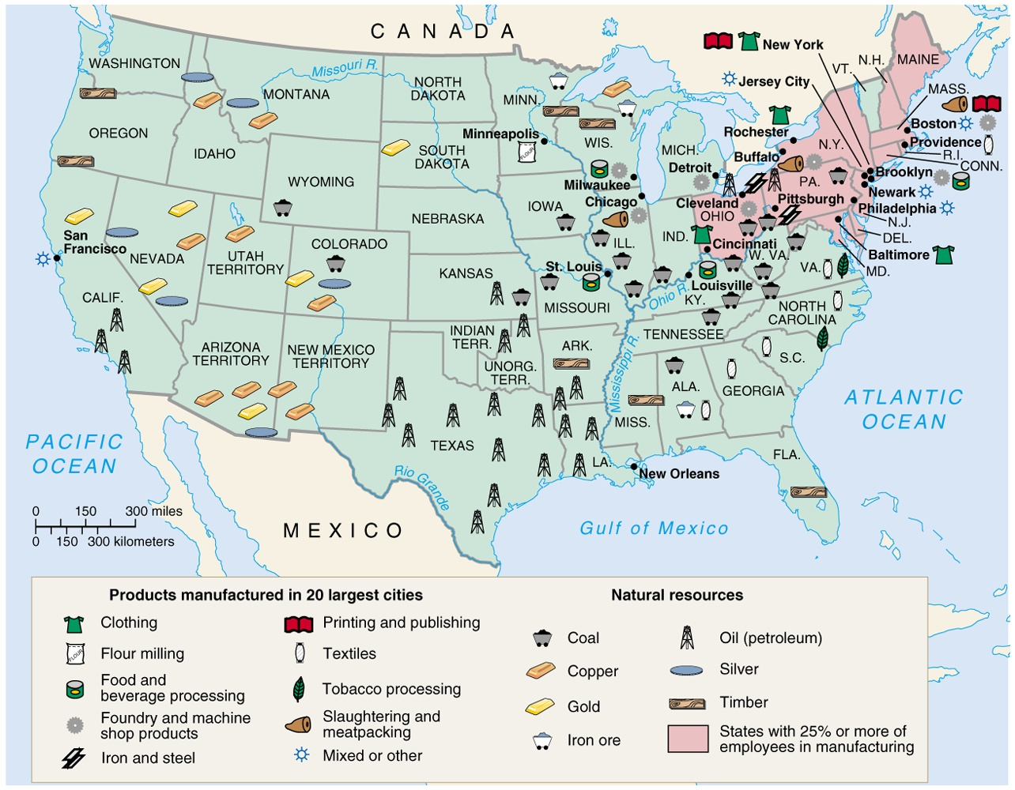

Slide 5
Captains of Industry OR Robber Barons
Using four business entrepreneurs as case studies for American innovation, industrial growth, and expansion of capitalism.
Cornelius Vanderbilt
Andrew Carnegie
John D. Rockefeller
J.P. Morgan

Slide 6
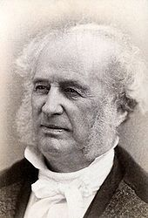
Captains of Industry OR Robber Barons:
Cornelius Vanderbilt and Railroads
Acquired his wealth in steamships and expanded into railroads in 1860s
Revamped northeast railroads through consolidation and standardization
  New York Central Railroad
  Regional railway system from New York to Chicago
  Replaced and built lines with standard gauges
Implementation of steel
  Stronger to carry heavier loads
  Safer due to no corrosion
Vanderbilt University

Slide 7
Railroads Drive the Economy
Growth and Influence
  35,000 miles (1865) to 200,000 miles (1900)
  First Transcontinental Railroad (1869)
    Leland Stanford’s Union Pacific and Central Pacific meet at Promontory Summit, UT
  Market connections, boomtowns, and jobs
Federal Government Involvement
  Pacific Railway Acts
    Land grants and government bonds to railroad companies
    Requirement of standardized gauges
  By 1871, federal and state governments sold 300,000,000 acres of land to railroads
Innovation and Improvement
  Standardized gauges
  Westinghouse air brakes
  Steel
  Time zones

Slide 8
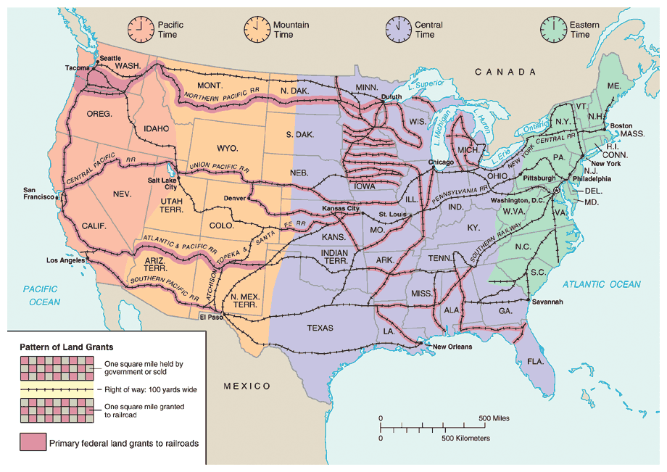

Slide 9
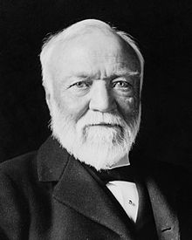
Captains of Industry OR Robber Barons:
Andrew Carnegie and Steel
Managed Pennsylvania Railroad and invested in various industries
Steel
  Bessemer Process
Vertical Integration
Urbanization and Cities
Labor Unions and Strikes

Slide 10
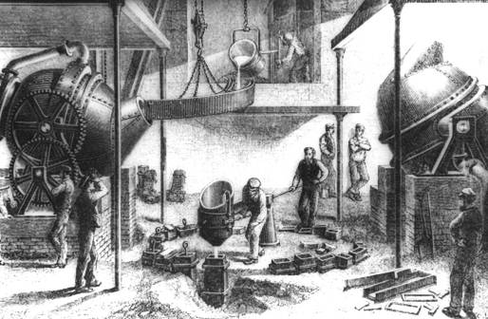
Bessemer Process
Oxidation of iron ore to remove impurities
  Steel is lighter, stronger, rust-resistant
Carnegie and Steel
  Adopted and adapted Bessemer Process to steel plants
  Increased supply of quality steel dropped steel prices
  Abundance of steel significantly impacted American industrial growth and expansion

Slide 11
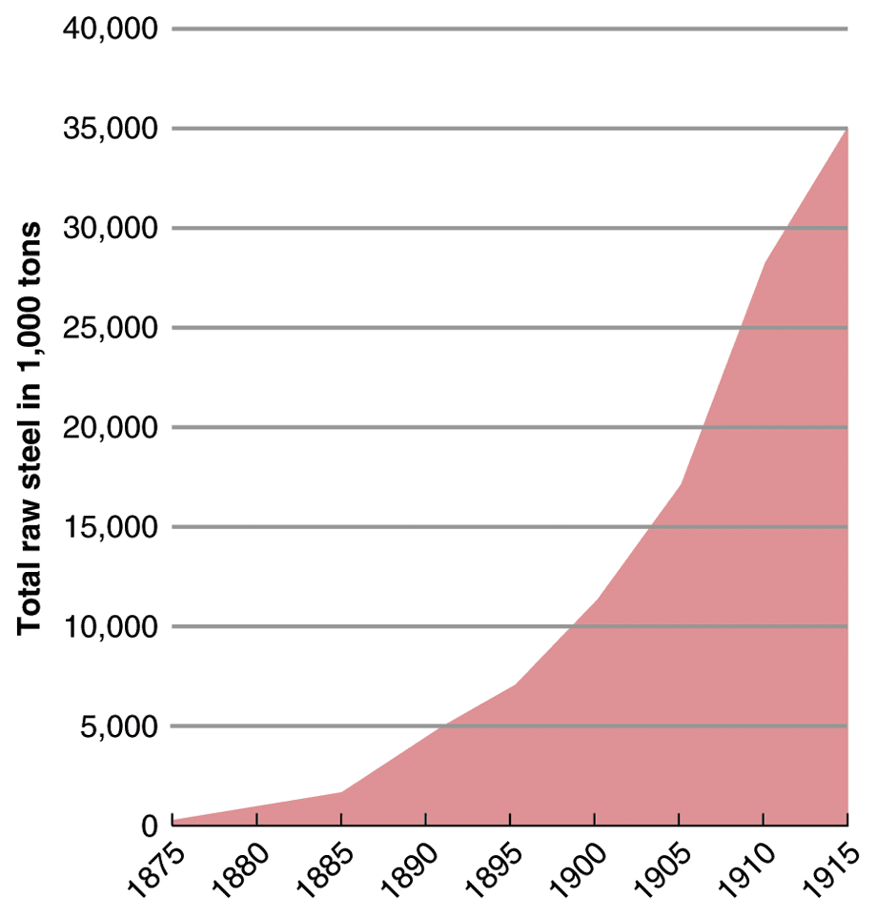
Steel Production

Slide 12
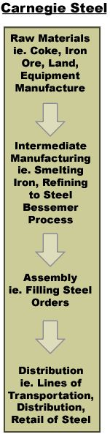
Vertical Integration
Carnegie acquired all aspects of steel production
Limited competition, maximized profits, lowered prices

Slide 13
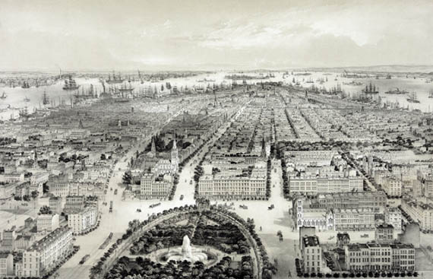
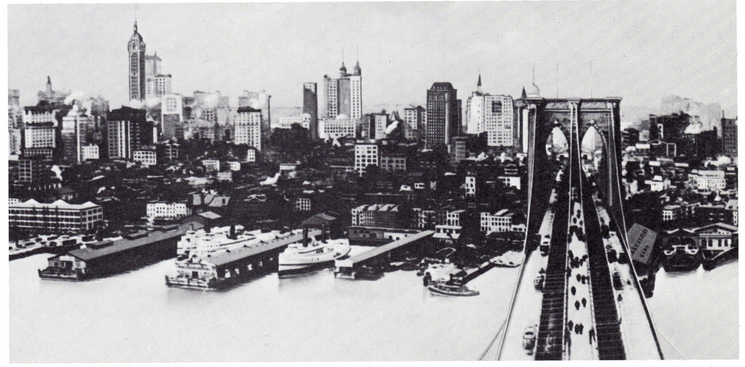
Steel and Cities
Buildings
  Skyscrapers
    Steel beams
Infrastructure
  Railroads
  Bridges
    Brooklyn Bridge
Urban Innovation
  Mass Transit
    Elevated rails
    Subways
  Elevators
  Central steam-heating systems

Slide 14
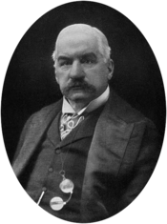
Captains of Industry OR Robber Barons:
J.P. Morgan and Electricity
Banking and Financing
Science and Innovation
Corporations
Consumerism
American Culture

Slide 15
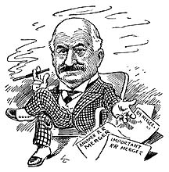
Morganization
J.P. Morgan and Co.
  Financial capital and investment
  Directly and indirectly pursued inventions and innovations
Mergers and Consolidations
  Railroad industry
Interlocking directorates
  Corporate board of directors sitting on boards of multiple corporations

Slide 16
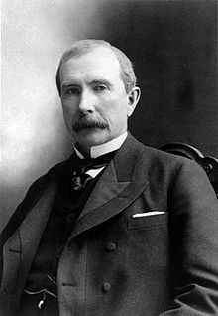
Captains of Industry OR Robber Barons:
John D. Rockefeller and Oil
Horizontal Integration
Standard Oil
  Trusts and monopolies
Sherman Anti-trust Act (1890)
Gilded Age Society
Social Darwinism
Gospel of Wealth

Slide 17
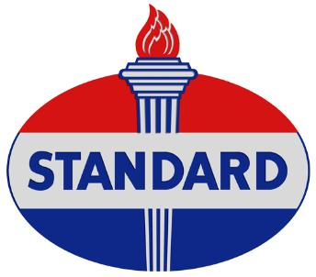
Standard Oil
Rockefeller established Standard Oil in 1870
Uses for Oil
  Kerosene lamps
  Fuel for railroads
Used vertical integration to control oil industry then horizontal integration to control oil market
Eventually controlled 95% of oil refining

Slide 18
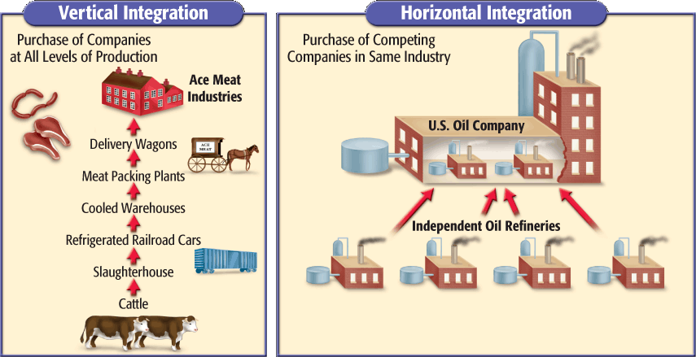
Horizontal Integration

Slide 19
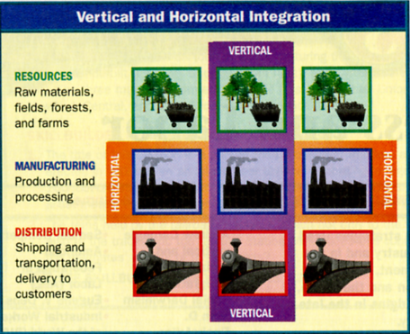

Slide 20
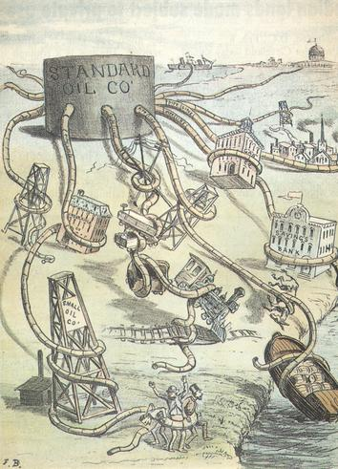
Robber Barons and Trusts
Tactics of Standard Oil
  Lowered prices to drive out competitors
  Threatened companies to sell to Standard Oil (buyouts)
  Bribed railroads to buy Standard Oil fuel (rebates, kickbacks)
  Bribed Congress members
Standard Oil Trust
  Stockholders’ shares traded for trust certificates
  Board of Trustees controlled and administered companies as a whole
  Shareholders earned dividends based on overall profits
Monopolies
  Controls prices
  Limits competition
  Pressure on other services to provide discounts and rebates

Slide 21
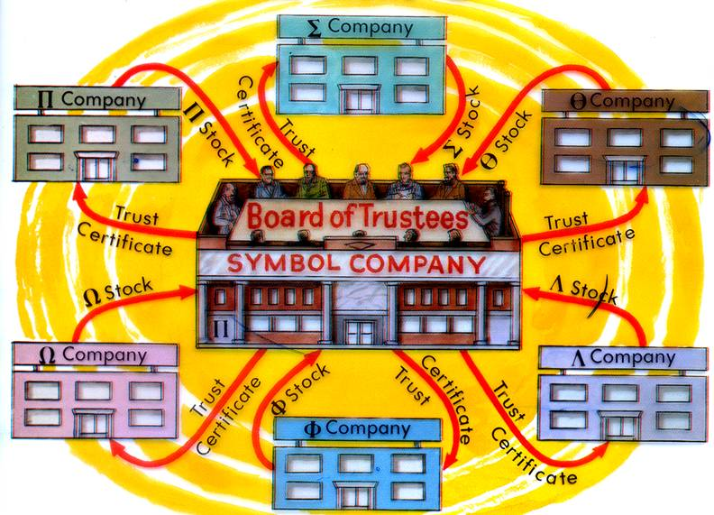

Slide 22
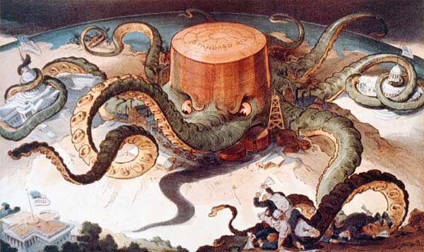
Antitrust Movement
Sherman Antitrust Act (1890)
  Prohibits any “contract, combination, in the form of trust or otherwise, or conspiracy in restraint of trade or commerce”
United States v. E.C. Knight Co. (1895)
  Sugar refining monopoly tested Sherman Antitrust Act
  Regulation applied to commerce and not manufacturing

Slide 23
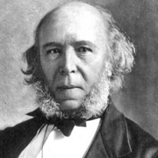
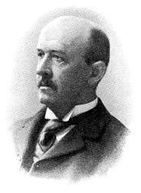
Laissez-Faire and Social Darwinism
Laissez-Faire Economics
  Economy driven by the “invisible hand” of market forces (supply and demand)
  Government should refrain from regulation or interference
Social Darwinism
  Herbert Spencer
    “Survival of the fittest”
    Wealth a result of hard work and brilliance
    Poor and unfortunate were lazy
  William Graham Sumner
    Absolute freedom to struggle, succeed, or fail
    State intervention is futile
Gospel of Wealth
  Andrew Carnegie
  Guardians of the nation’s wealth
  “All revenue generated beyond your own needs should be used for the good of the community.”

Slide 24
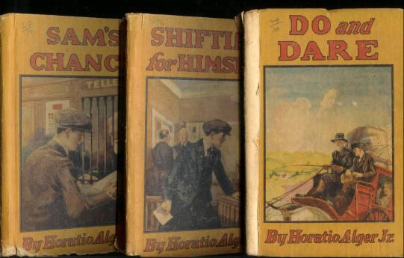
Horatio Alger Myth
“Rags to riches” stories
  Young American men, through hard work and virtue, will succeed
  Also used a supporting wealthy philanthropic character
Seemingly propaganda of the American Dream under free enterprise and capitalism

