Slide 1
The 13 Colonies

Slide 2
13 Colonies Compared
Geography
Political
Economic
Social
Religion

Slide 3
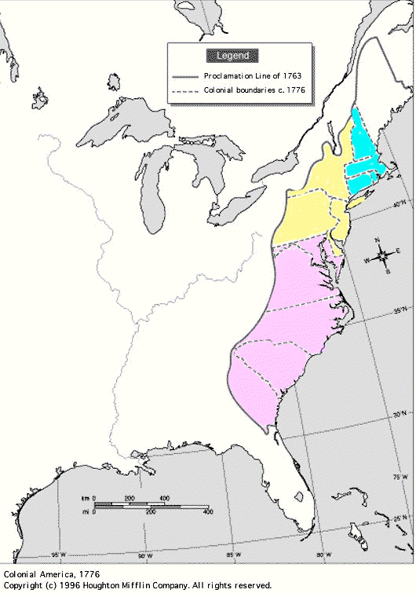
13 Colonies Compare/Contrast Chart
Key Colonies
New England
Massachusetts
Rhode Island
Middle
New York
Pennsylvania
Southern
Maryland
Virginia
Carolinas (N & S)
Georgia

Slide 4
13 Colonies Regions Compare & Contrast Chart
- Geography -
 | NEW ENGLAND | MIDDLE | SOUTHERN
Geography - Features that make the region unique
- Farthest north.
- Cooler Climate:
- Shorter growing
season.
- Helped prevent
disease.
- Cold weather
killed many.
- Mostly hills &
rocky soil.
- Natural resources more important than agricultural crops.
- Temperate climate:
- Warm summers.
- Cold winters.
- landforms:
- Coastal plain.
- Piedmont
(rolling hills).
- Mountains.
- Good Harbors.
- Ideal for agriculture.
- Warmest climate:
- Helped colonists
survive winter.
- Warm, moist climate
carried disease.
- Broad coastal plain.
- Hilly & forests.
- Rich farmland,
forests & fish.

Slide 5
13 Colonies Regions Compare & Contrast Chart
- Politics -
 | NEW ENGLAND | MIDDLE | SOUTHERN
Politics Who was in charge? type of government? Important Documents?
- Mayflower Compact:
1.) Plymouth.
2.) Elected legislature.
3.) Gov’t of the people.
- Representative gov’t
- Town meetings.
- Ultimately – power in
hands of the Church.
- Fund. Orders of
Connecticut:
1.) Gov’t power from
“free consent of the
people”.
- Toleration
- Indian treaties.
- Eventually became royal colonies (governor controls).
- House of Burgesses
1.) Jamestown (1619)
2.) 1st Representative
body in colonies
- Eventually became
royal colonies
(governor controls).

Slide 6
13 Colonies Regions Compare & Contrast Chart
- Economy -
 | NEW ENGLAND | MIDDLE | SOUTHERN
Economy - Income Occupations Crops Grown Products
- Relied on the Atlantic
Ocean:
- Shipbuilding.
- Trade.
- Fishing.
- Triangular Trade
Routes:
- Traded goods for
rum, sugar cane,
& molasses, then
for slaves.
- Key trade port:
Boston, MA
- Small farms.
- Depended on farming
& commerce (trade).
- Staple Crops:
- Wheat.
- Barley.
- Rye.
- “Breadbasket
Colonies”
- Urban centers like
New York &
Philadelphia.
- Ports & Diversity.
- Fur Trade.
- Some slaves.
- Hot & wet =
agriculture.
- Cash crops:
- Tobacco.
- Rice.
- Indigo.
- Forests:
- Pitch.
- Tar.
- Turpentine.
- Plantation
system = slavery.
- No major
commercial cities.

Slide 7
13 Colonies Regions Compare & Contrast Chart
- Society -
 | NEW ENGLAND | MIDDLE | SOUTHERN
Society - Where from? Types of people (backgrounds) - Education - Social classes - Events
- Founded on religion
(Puritan faith).
- “City Upon a Hill”.
- John Winthrop.
- Strong sense of faith,
family, & community.
- Very strict.
- Massachusetts =
1st public education
(1647).
- First two colleges:
- Harvard & Yale.
- Diversity.
- Religious tolerance.
- Fast growth:
- Westward
expansion.
- Philadelphia =
largest colonial
city.
- Social order:
1.) Merchants (U).
2.) Craftsmen, Retail,
businessmen (M).
3.) Sailors, unskilled
workers, & some
artisans (L).
- Social order:
1.) Plantation owners.
2.) Poor farmers.
3.) Slaves.
- Wealthy = gentry.
Tutors or private
schools.
- Poor = home school.

Slide 8
13 Colonies Regions Compare & Contrast Chart
- Religion -
 | NEW ENGLAND | MIDDLE | SOUTHERN
Religion(s) Major religious groups Freedom of religion?
- Puritan Church.
- Church central to colonial life.
- ALL settlers had to
attend & support the
Church.
- Banishment for
non-committed.
- Great social &
religious diversity.
- Pennsylvania.
- Founder:
William Penn.
- Quakers.
- Religious
Tolerance.
- Presbyterians.
- Lutherans.
- Mennonites.
- Jews = New York.
- Colonies founded
for economic rather
than religious
reasons.
- Exception:
- Maryland
(Catholic).
- Planters = Church of
England (Anglican).
- Poor settlers =
Baptists &
Methodists.

